Slide 1
Name of Project
Art Bible
Note: Please change the style of this slideshow to fit in with the theme of your concept

Slide 2
Contents:
Fill these in
Fill these in
Fill these in
Fill these in

Slide 3
Introduction
Concept: What is the concept? And what are it’s basic requirements?

Slide 4
Art Style
Environment
Scale?
Who Inhabits it?
Time Period?
Climate?
Architecture?
Lighting/Shaders
Global Illumination?
Shadows?
Baked lighting?
Painted in textures?
Handpainted?
PBR?
Characters
Proportions?
Theme?
Clothing?

Slide 5
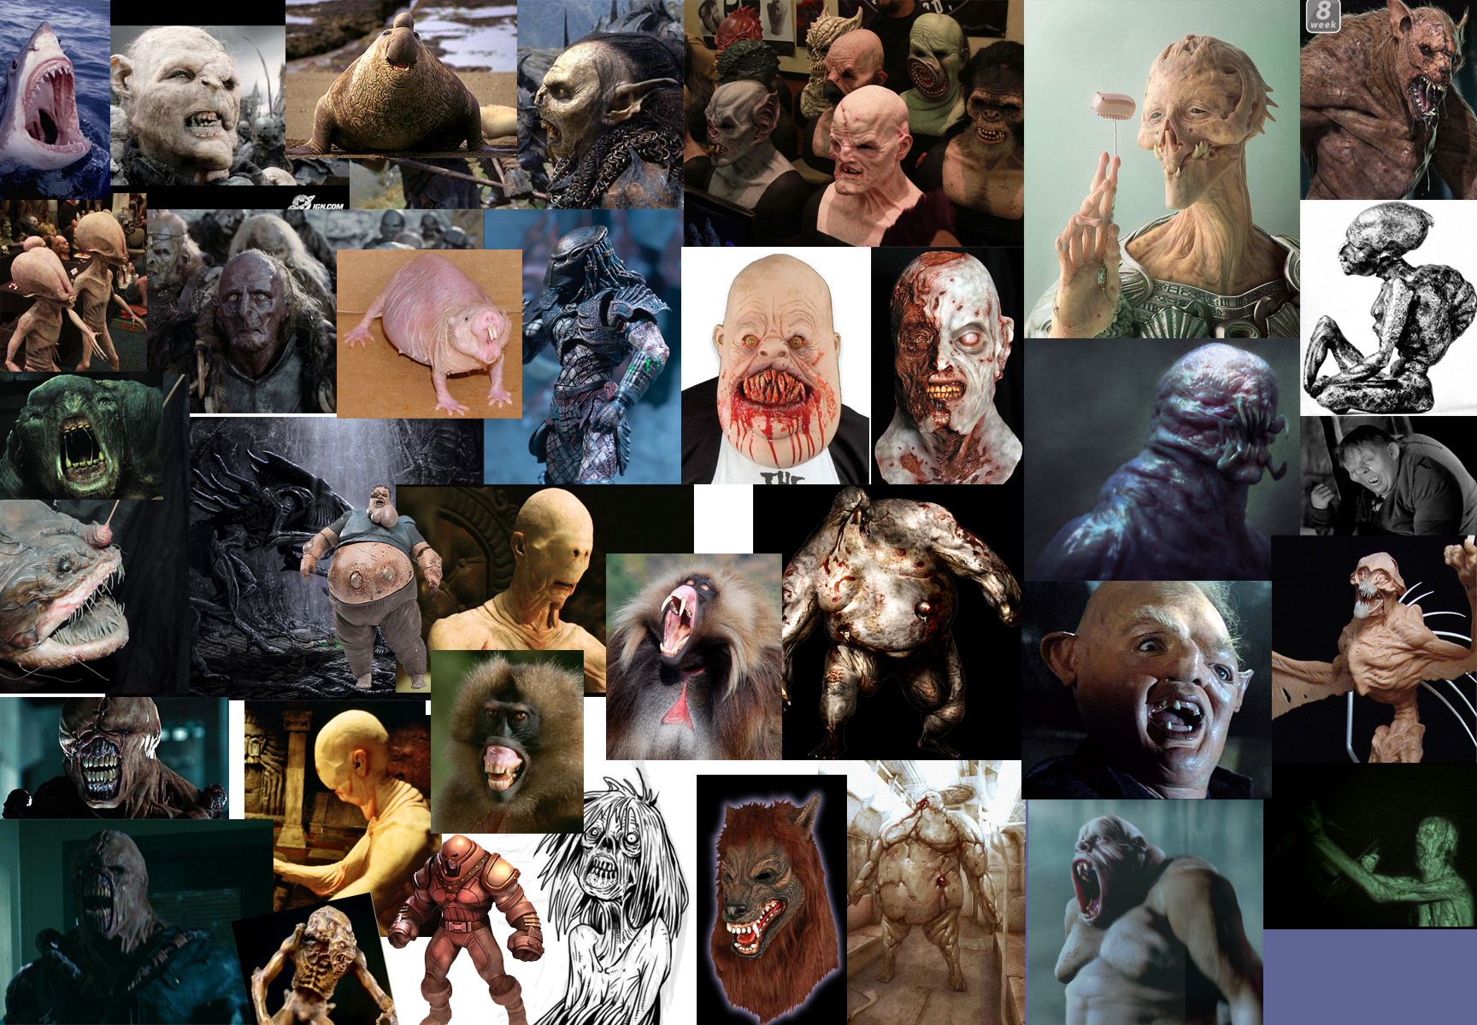
References
Fill with a range of images for each main item of the project
i.e. characters, environments, props, effects
EXAMPLE>

Slide 6
Bio Sheet – Characters EXAMPLE
BASIC INFORMATION Full name: Pronunciation: Nickname(s) or Alias: Gender: Species: Age: Birthday: Sexuality: Nationality: Religion: City or town of birth: Currently lives: Languages spoken: Native language: Relationship Status:
PHYSICAL APPEARANCE Height: Weight: Figure/build: Hair colour: Hairstyle: Facial Hairstyle: Eye colour: Skin/fur/etc colour: Tattoos: Piercings: Scars/distinguishing marks: Preferred style of clothing: Frequently worn jewellery/accessories: HEALTH Smoker? Drinker? Recreational Drug User? Which? Addictions: Allergies: Any physical ailments/illnesses/disabilities: Any medication regularly taken:
PERSONALITY Personality: Likes: Dislikes: Fears/phobias: Favourite colour: Hobbies: Taste in music: SKILLS Talents/skills: Ability to drive a car? Operate any other vehicles? EATING HABITS Omnivore/Carnivore/Herbivore (Vegetarian): Favourite food(s): Favourite drink(s): Disliked food(s): Disliked drink(s): HOUSE AND HOME Describe the character's house/home: Do they share their home with anyone? Who? Significant/special belongings:
CAREER Level of education: Qualifications: Current job title and description: Name of employer: COMBAT Peaceful or aggressive attitude? Fighting skills/techniques: Special skills/magical powers/etc: Weapon of choice (if any): Weaknesses in combat: Strengths in combat: FAMILY, FRIENDS AND FOES Parents names: Are parents alive or dead? Is the character still in contact with their parents? Siblings? Relationship with siblings? Other Important Relatives: Partner/Spouse: Children: Best Friend: Other Important Friends: Acquaintances: Pets: Enemies? Why are they enemies? BACKSTORY Describe their childhood (newborn - age 10): Describe their teenage years (11 - 19): Describe their adult years (20+):

Slide 7
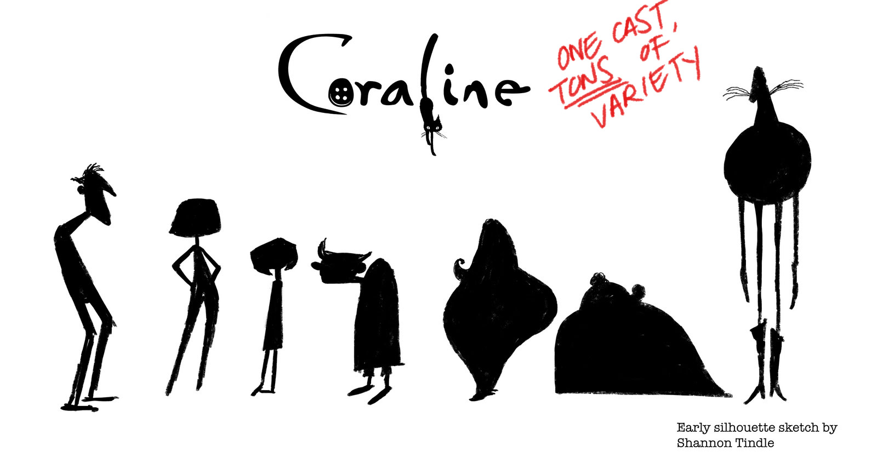
Silhouettes
Experiment with the overall proportions of the character’s design and style and how well it reads
EXAMPLE>

Slide 8
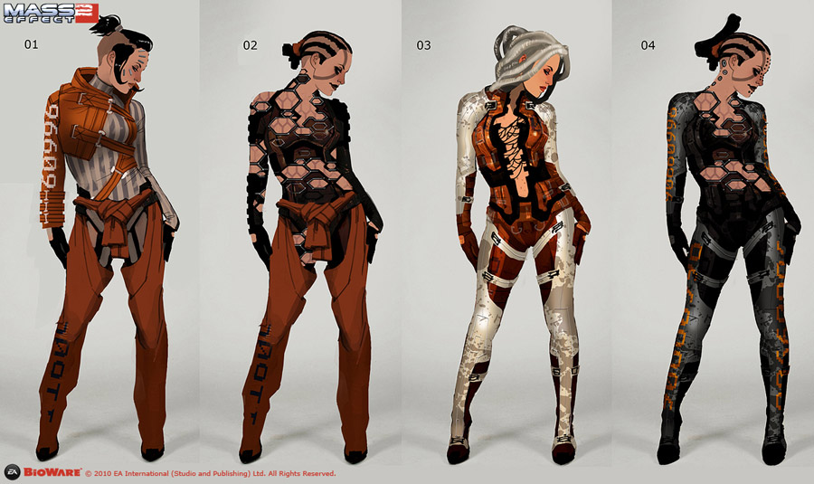
Concept Art
Once proportions and a silhouette has been settled on, start experimenting with the rest of the concept of the character
EXAMPLE>

Slide 9
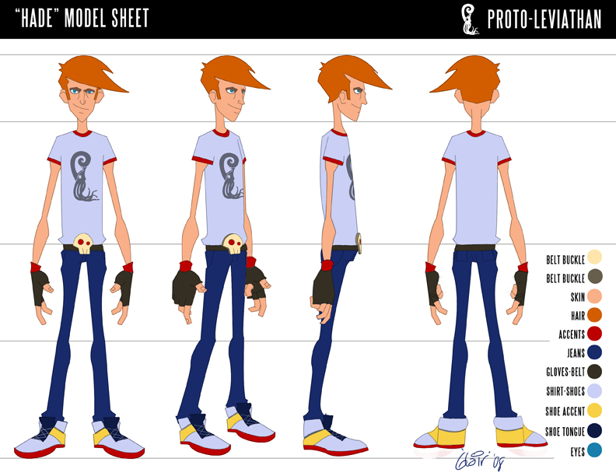
Model Sheets
Once the concept art has been completed, create model sheets for artist to create the character/object in 3d
EXAMPLE>

Slide 10
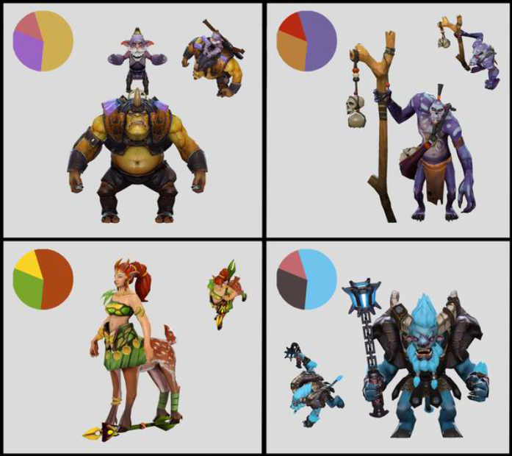
Colour Palettes
Colours also need to be defined. (Can be done during concepting but want to see you’ve put thought behind your decisions)
EXAMPLE>
Check out: https://color.adobe.com/

Slide 11
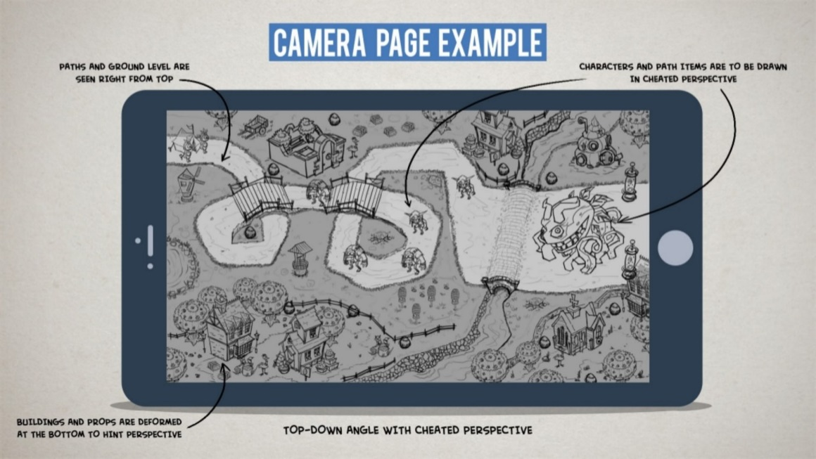
Camera
What is the gameplay angle?
Where is the character positioned?
What is the FOV of the Camera?
Perspective?
Orthographic?
Are there any special effects added to the camera?
EXAMPLE>

Slide 12
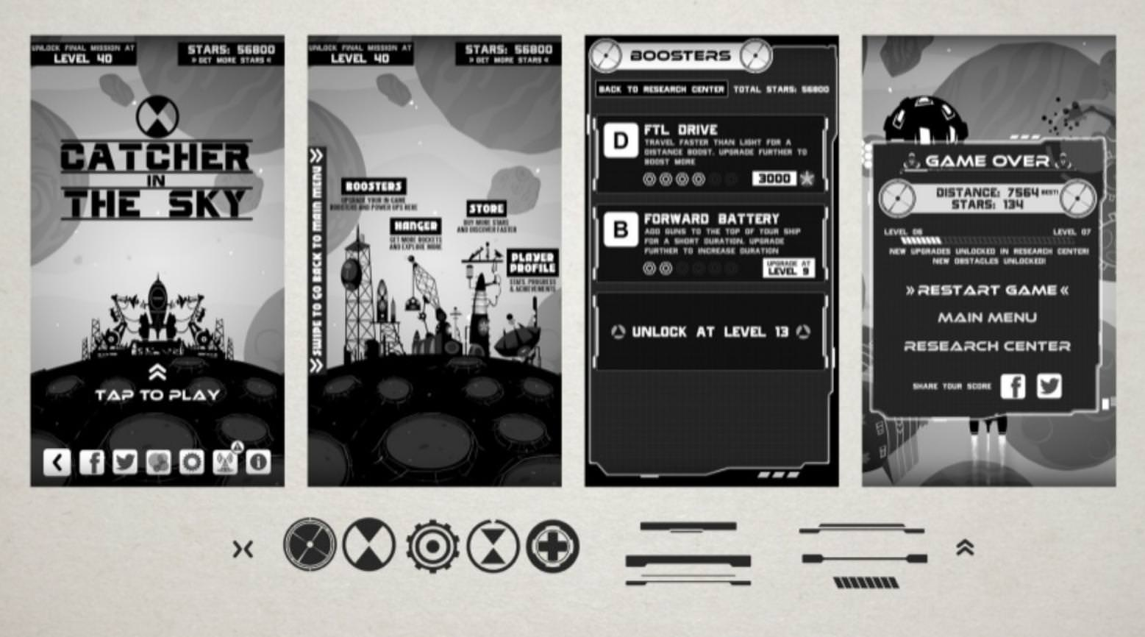
User Interface
What will the UI look like?
How will items fit into a theme?
Where will the items be positioned?
What will the main menu look like?
Will the UI have any animations?
EXAMPLE>

Slide 13
Technical Constraints
Target Platform?
Software being used?
Naming Convention?
Polycounts?
Texture Sizes/Formats?
Audio Formats?
Note: This can be in conjunction with the programmers

Slide 14
Asset List
Asset List:
(Everything must be listed here! If it’s not listed it’s not in the game, this includes audio too!)
example
example
example
example
example
example
example
example
example
example
example
example
example
example
example

